Slide 1


Slide 2
Project Overview

Slide 3

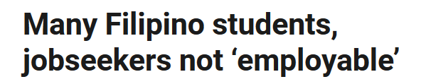

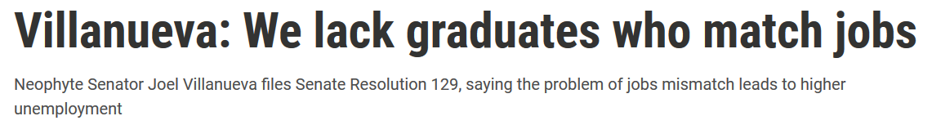
Skills Gap & Mismatch
Problem

Slide 4
Proposed Solution

Slide 5

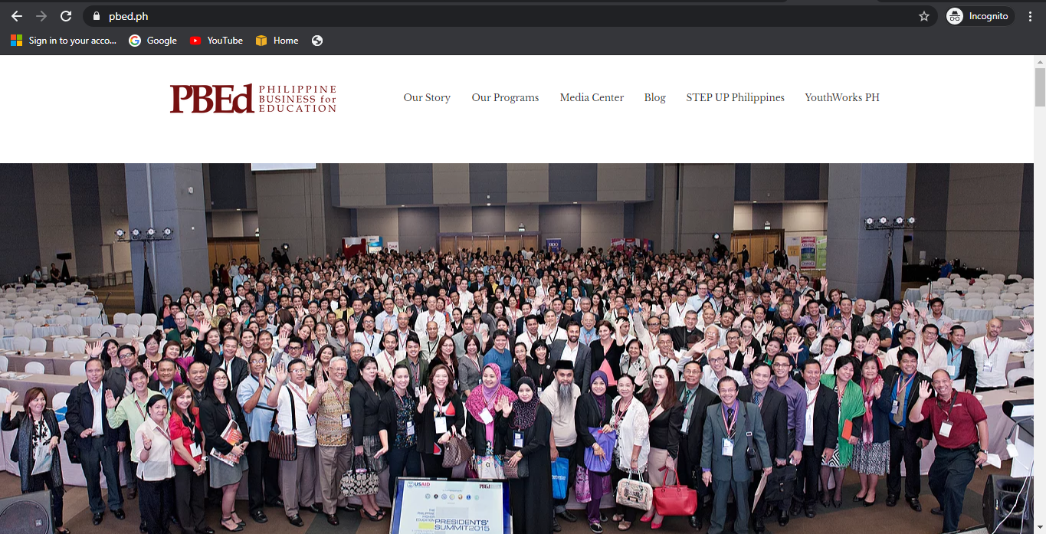

Description
Solution
Add a Service in the Existing Website of Nonprofit Organization (pbed.ph)
IBM Watson Discovery
IBM Personality Insights

Slide 6

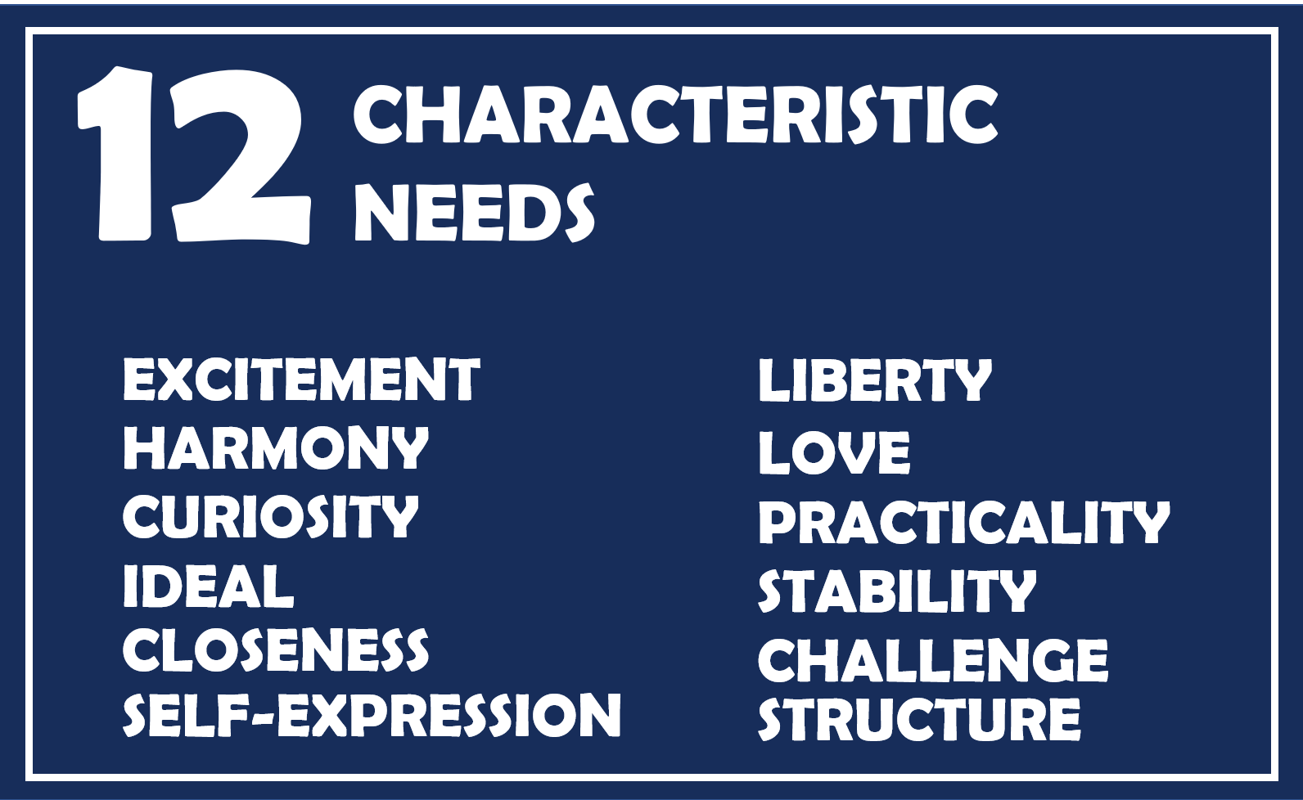
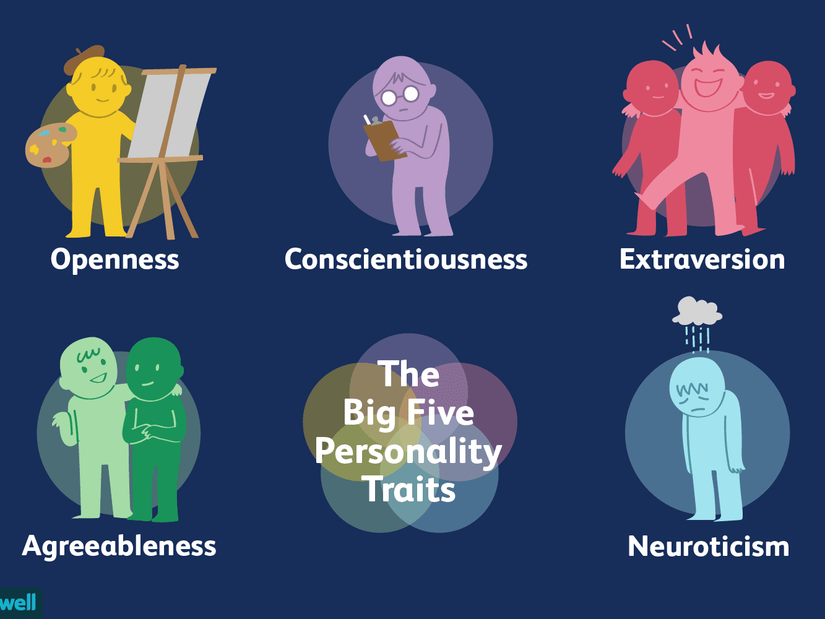
Description
Solution
Personality Insights

Slide 7
Description
Solution
Trainings
Watson Discovery
Courses
Job Opportunities

Slide 8


Target Audience
Job Seekers
Fresh Graduates

Slide 9
Demo

